Slide 1
Building a Foundation for Financial
Freedom
www.oppffcu.com
Presented By : Curtis Baylor

Slide 2
About OPPFFCU
Began in 1986
All members of the fraternity are eligible to apply for membership as well as their family members, and members of any of the Divine Nine organizations
Provides life membership loans
The Omega Psi Phi Fraternity was the first of the Divine Nine organizations to start a credit union.
www.oppffcu.com

Slide 3
OPPFFCU
Products and Services
Accounts
Checking
Savings
Money Market
Loans
Auto
Debt Consolidation
Life Membership
Financial Support (in partnership with Balance Pro)
Coaching for debt, budgeting, home buying, and student loans
Toolkits and Calculators
www.oppffcu.com

Slide 4
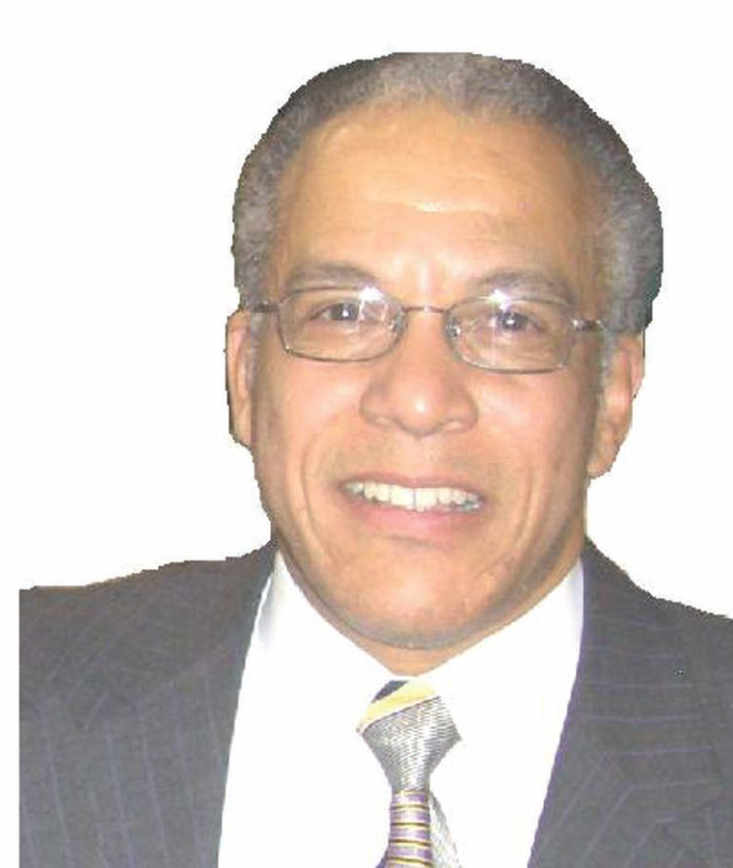
About Your Speaker
Serves on OPPFFCU’s board of directors and has over 20 years of experience helping individuals and families develop plans tailored to help them achieve what he calls financial freedom.
Has a BS in Industrial Engineering (Purdue) and an MBA Mgmt. (Loyola Baltimore, MD)
Has Series 6, 63, and 65 (added training on Federal Employees and Retirees)
Has Life and Health Insurance license (added training for Long-Term Care and Medicare)
Has experience as an adjunct professor teaching both Personal and Business Finance
www.oppffcu.com

Slide 5
Agenda
Today, we will look at the impact of good money management on your wealth journey, the biggest mistakes people make when it comes to accumulating debt and investing, and the tools you need to both avoid and overcome bad habits. At the end you will:
Have an appreciation for the basics of credit, its use, and its impact on your pursuit of wealth
Understand the importance and impact investing has on your standard of living
Be able to prepare and adjust a budget by which to manage your money
www.oppffcu.com

Slide 6
Journey to Wealth
Steps to Help You Build Wealth
Start by making a plan (set your goals)
Make a budget and stick to it (Do not use credit to pay your bills.)
Build your emergency (3 to 6 months) and pay cash funds
Automate your financial life (Pay recurring bills via automatic bank draft)
“Manage your debt from the start and continue to do so”
(Good Debt = Needs and Aids to Building Wealth (e.g. education, home ownership, business start up) vs. Bad Debt = Impulse wants and buys, unrealistic lifestyle, and timeshare)
Track your credit score
Match your investments to your goals (e.g. retirement(401k), education (529), home (other))
Stay diversified (know your risk tolerance) and invest towards multiple income streams
Save and invest more as you up your earnings
www.oppffcu.com

Slide 7
Journey to Wealth Challenges
Far too many folks find themselves dealing with one or more of the following challenges in their pursuit of wealth:
Challenge One:
no budget, an unrealistic budget, or a budget that is
not working well for them
Challenge Two:
no credit, poor credit, or damaged credit
Challenge Three:
no investments, insufficient investments upon
which to retire, or diminishing investments in retirement.
Let’s take a look at these challenges. When we are done, you will have a
roadmap to address and overcome each of them.
www.oppffcu.com

Slide 8
Challenge One: Budget
No budget – Simply put if you have no budget, you have no plan or desire to pursue wealth. To become wealthy, you need to manage your money.
An unrealistic budget – Your budget needs to be “zero-based”. This means it covers and accounts for all that you bring in and all that you pay out. Pay yourself first, pay your taxes, and live off what is left.
A budget that is not working well for you - Your budget must be tied to your financial goals (e.g. savings, retirement, home, etc.)
www.oppffcu.com

Slide 9
Challenge Two:
Credit
No credit – Start as soon as you can. The best time to establish your credit is when you do not need it.
Poor Credit - Stick to “good debt” and Stay away from “bad debt”.
Calculate your debt to income (DI) ratio before you borrow (DI = Monthly debt payments ($2,100) / ($7,000) Monthly Income = 30%).
Keep your monthly unsecured debt balance at or under 10% of your annual income ($5,000 / $50,000 = 10%).
Damaged Credit – Know and track the elements of your credit score. Obtain a copy of your credit report and address those areas that are damaged.
www.oppffcu.com

Slide 10
Challenge Three: Investments
No Investments – Start with your first job. Investments are generally the best hedge against inflation.
Insufficient investments– Invest towards your goals and account for taxes, inflation and market fluctuations.
Diminishing investments – Keep an eye on your nest egg. Adjust your mix and your draw downs to prevent running out of money.
www.oppffcu.com

Slide 11
Checklists
Budget Checklist
Zero Based (covers all in and all out)
Allocation
God – 10%
Yourself – 20%
Savings (emergency (3-6 mos.) and pay cash) 5%
Insurance (health, income, and life) 5%
Investment Goals - 10%
Taxes (Federal, State, SS (6.2%), and Medicare (1.45%)) – 25%
Living Life – 45%
Living expenses (needs before wants)
Food – 10% - 15%
Shelter & Utilities – 25% - 30%
Transportation (vehicle, fuel, maintenance, insurance) – 15% - 20%
Personal (Clothing, grooming, hobbies) – 5% - 10%
Travel & Entertainment – 5% - 10%
Addresses financial goals (home ownership, retirement, education)
Credit Checklist
Start as soon as you can
Good Debt vs. Bad Debt
Debt to Income ratio (housing 31% and total 43%)
Monthly unsecured debt balance (at or under 10%)
Obtain and maintain a good credit score
www.oppffcu.com

Slide 12
Case Study: Background
New Teacher
Makes $35,000/yr.
Limited Credit
One small individual credit card-$750 limit-$20/mo. payment
Authorized user on parents' credit card-$9,000 limit-Parents pay
$70,000 in student loan debt in deferment
Rent is $650/mo. and lives alone
Purchases a new vehicle-$28,000 at 7.50% for 78 months for a monthly payment of $455/mo.
Let’s look at the scenario:
www.oppffcu.com
www.oppffcu.com

Slide 13
Resources
7 Important Financial Tips From the Bible – Verses About Money By Amy Livingston
Personal Finance For Dummies By Eric Tyson
Saylor Personal Finance - Saylor Academy Textbooks saylor.org
Visit www.oppffcu.com – Clink the link to BALANCE
www.oppffcu.com

Slide 14
Contact Us
Learn more about our services
Info@oppffcu.com
800-42-OMEGA
www.oppffcu.com

Slide 15
QUESTIONS?

