Slide 1


Building Wealth Through Homeownership
Journey to Wealth Series
Presented By : Nigel Hopson and Jason Paulateer of Fifth Third Bank
www.oppffcu.com

Slide 2


About OPPFFCU
Began in 1986
All member of the fraternity are eligible to apply for membership as well as their family members, and members any of the Divine Nine organizations
Provides life membership loans
The Omega Psi Phi Fraternity was the first of the Divine Nine organizations to start a credit union.
www.oppffcu.com

Slide 3

Products and Services
Accounts
  Checking
  Savings
  Money Market
Loans
  Auto
  Debt Consolidation
  Life Membership
Financial Support (in partnership with Balance Pro)
  Coaching for debt, budgeting, home buying, and student loans
  Toolkits and Calculators
www.oppffcu.com

Slide 4

About Fifth Third Bank
For 165 years, we have been listening to our customers and
inspiring them with smart financial solutions aimed at making
their lives and business a Fifth Third Better®. Our operating
priorities—stability, profitability and growth, in that order—are
the lens through which we make strategic decisions and are
reflected in the discipline with which we run our business. Our
ambition is to not only be the nation’s best performing regional
bank, but to be the one bank people most value and trust.
As a standalone country, the GDP of Fifth Third’s retail footprint states would represent the world’s 3rd largest economy.
www.53.com

Slide 5
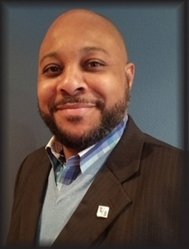
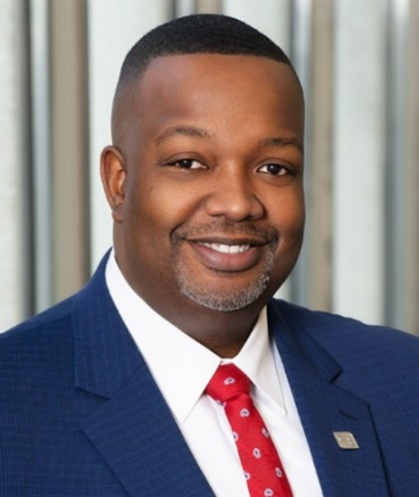
About Your Speakers
Nigel Hopson
Award winning Senior Mortgage Banker with Fifth Third Bank
20+ years of lending experience
Specializes in residential purchase and community lending to help the underserved community
BS in Finance from Eastern Michigan University
Member of Omega Psi Phi since 2003
Jason Paulateer
Senior Vice President and Group Head of Community Business Lending for Fifth Third Bank
25+ years of banking and community experience
Instrumental in helping the bank to establish the Neighborhood Investment Program
Bachelor’s degree in Business Management and master’s degree in Finance from Grand Valley State University
Member of Omega Psi Phi since 1994
www.oppffcu.com

Slide 6
Agenda
Today we will discuss
DECISION
THE DO’S
NEXT
Is homeownership right for you?
Renting vs. Owning: A comparison
We will walk you through the Do’s and Don’ts of purchasing a home.
What are the next steps on this journey?
www.oppffcu.com

Slide 7

Topics Covered in this Presentation
Is owning right for you?
Owning vs. Renting: A Comparison
Do’s and Don’ts of buying your first home
What to expect from your lender
Steps to get started today
FAQs

Slide 8
Is Owning Right For you?
 | Advantages | Disadvantages
Own | Opportunity to build equity Gain sense of community Free to decorate/landscape to your taste Not dependent on landlord for repairs or maintenance Potential tax benefits* | Responsible for maintenance Responsible for property taxes Less mobility compared to renting
Rent | Little to no responsibility for maintenance Easier/quicker to relocate | No tax benefits* Not gaining any equity No control over rent increases
* Consult your tax advisor regarding the deductibility of interest.

Slide 9
Owning vs. Renting: A Comparison
7-Year Scenario | Rent ($) | Own ($)
Monthly Rent | 117,756 | N/A
Monthly Mortgage Payments | N/A | 66,108
Taxes | 0 | 18,480
Renter’s/Homeowner’s Insurance | 2,520 | 4,347
Mortgage Insurance | N/A | 12,348
Maintenance | 0 | 11,550
Total Payments (Before Tax Savings) | $ 120,276 | $ 112,833
Total Payments (After Tax Savings*) | $ 120,276 | $ 96,572
Savings Summary | Rent ($) | Own ($) | Savings ($)
Payments | 120,076 | 112,833 | 7,443
Tax Savings* |  | 16,261 | 16,261
Investment/Appreciation |  | 63,046 | 63,046
Selling Expense (in 7 years) |  |  | -12,091
Original Down Payment Expense |  |  | -5,000
Origination Expense |  |  | -1,347
Total Ownership Savings |  |  | $ 68,312
!
Buying your home versus
renting it may save you more than $68,000 over the next seven years.
Scenario based on purchasing a $165,000 property with 5% down payment. All assumptions found on page 17 of this presentation.
* Consult your tax advisor regarding the deductibility of interest.

Slide 10

The Do’s of Buying Your First Home
Get pre-qualified for a loan
Signals you are a serious shopper
Tells sellers you are qualified to purchase a home
Know what you can afford before you start shopping
Be realistic about needs and wants
Think about how long you’ll stay at this property
Consider school district reputation, nearby shopping and commute times
Clearly communicate needs to your real estate agent

Slide 11

The Do’s of Buying Your First Home continued
Shop for a loan
Not all mortgages are created equal
Understand the best loan program for your personal situation
Search for the most competitive rates
Get your finances in order
Gather tax returns, bank records and credit reports
Follow our tips to get your finances ready
Learn about home buying programs
Special national, state and local assistance programs are available for qualified buyers
Counseling programs are also available

Slide 12

The Do’s of Buying Your First Home continued
Use a real estate agent
Ask friends and family for referrals
Seek out experience, commitment and full-time status
Real estate agents know the market inside and out and will help you navigate your local market
Real estate agents represent your best interests and have access to listings, schedule showings and work for you in negotiations
Interview several real estate agents to determine best the best fit for you

Slide 13

The Do’s of Buying Your First Home continued
Hire a home inspector
Protect yourself from unexpected problems
Hiring your own inspector ensures your best interests are maintained
Consider hiring a real estate attorney
Provides second line of defense to ensure your best interests are maintained
Seek referrals from friends, family, real estate agents or Loan Originators
Request a seller-paid home warranty
If purchasing existing property, a home warranty covers against unexpected failure of key appliances and home systems
After the first year, renew at your own expense

Slide 14

The Don’ts of Buying Your First Home
Don’t rush—take your time finding the perfect home
Don’t negotiate contracts without your real estate agent
Don’t buy more than you can afford to pay on your current salary
Don’t underestimate the power of competing buyers
Don’t be afraid to ask questions
Don’t feel pressured to make a decision if you’re not comfortable
Don’t open additional credit accounts (i.e., car loan, store credit card, line of credit, etc.)

Slide 15

What to Expect from Your Lender
Help determining affordability.
Debt-to-Income (DTI) Ratio measures how much of your gross income you’re using to cover all your debts including mortgage, auto loan, credit cards, student loans, utilities and more
Acceptable DTI ratios vary between 28% and 40% for most lenders
EXAMPLE
$5,000
Total monthly pre-tax income
28% to 40%
Acceptable DTI Ratio
$1,400 to $2,000
Acceptable total debt payments

Slide 16
What to Expect from Your Lender
Mortgage costs to expect:
Tax Escrow/Proration: typically a portion of property taxes are collected at closing and deposited into an escrow account. You’ll be making monthly payments into the escrow account along with your monthly payments and the account will be used to pay future property tax bills.
Prepaid Homeowner’s Insurance: typically one year of property insurance is required to be paid prior to closing.
Processing Fees: charges paid to lender for underwriting mortgage.
Title Fees: fees incurred to adequately ensure no liens exist on the home you intend to purchase.
Application Fee: nonrefundable fee to cover costs associated with processing your application and credit history.
Appraisal Fee: costs incurred to determine property’s fair market value.
Earnest Money: funds paid to the seller once the contract is signed

Slide 17
What to Expect from Your Lender continued
Mortgage Programs:
Fixed Rate: Principal and interest rate are locked for the term of the loan.
Adjustable Rate Mortgage (ARM)*: Fixed payment and interest rate during the early years of your mortgage; payments and rate may increase after the initial fixed-rate period (typically between one and ten years).
Federal Housing Administration (FHA): Benefits those who would like to purchase a home but haven’t been able to put money away for the purchase, like recent college graduates, newlyweds or people who are still trying to complete their education. It may also benefit individuals whose credit has been marred by bankruptcy or foreclosure. Lowe down payment options may be available to the borrower.
Veterans Affairs (VA)**: VA mortgages are insured by the Department of Veterans Affairs and are available to military service veterans, reservists and active-duty service members. These loans make home financing easier and more affordable by offering some of the most generous approval requirements of any mortgage program.
Consult a Mortgage Loan Originator to see other options that fit your specific needs.
*After the initial fixed term of the ARM period, it is possible that the borrower’s payment may increase substantially over the remaining term of the loan.
**VA Loan Program is subject to VA eligibility certificate review. Those currently in active duty or in Reserves, widows and widowers of veterans, commissioned officers of the Public Health Service and the National Oceanic and Atmospheric Administration may also be eligible.

Slide 18
Get started today!
Step 1: Get your finances in order.
Pay bills on time. This is one of the best things you can do to ensure you qualify for a mortgage loan.
Inspect credit reports. Access your credit report regularly and check for errors. Do not make purchases on credit after submitting your mortgage loan application, as this my impact your DTI ratio and/or credit score.
Save for a down payment. The larger the down payment, the more equity you’ll have at closing.
Gather tax returns. Typically, lenders want to see the last two tax returns complete with W-2s.
Collect bank statements. Prepare to show good account management with the last 6–12 monthly checking account statements. Include savings, investment, IRA and 401k statements, too.
Take a homebuyer education course. Get a better understanding of budgeting, credit and the homebuying process from a certified, non-profit homebuyer counseling organization.

Slide 19

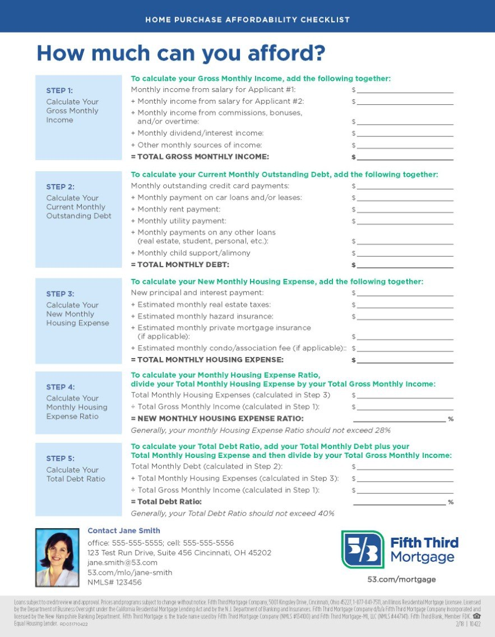

Get started today! continued
Step 2: Determine how much house you can afford.
Talk with a Mortgage Loan Originator about how a home fits into your budget, use the online affordability calculator or download and complete our affordability worksheet.

Slide 20
Get started today! continued
Step 3: Get pre-qualified and start the mortgage process.
Your Mortgage Loan Originator will be able to walk you through this step.
The following information will be needed during the mortgage process:
Sales contract (if you have already selected a property)
Social security numbers for all applicants
Driver’s license or state ID for all applicants
Employment information, including income
Copy of past two years W-2 forms (or tax returns if self-employed)
Copy of the most recent two pay stubs
Complete information on all open debts and other obligations (account numbers, balances, statements, etc.)
Complete information on assets (account numbers, balances, statements, etc.)
Copy of asset statements for the past two months

Slide 21

Get started today! continued
Step 4: Call the movers and pick up the keys to your new home!

Slide 22
Personal Balance Sheet aka
Personal Financial Statement
Most
ASSETS
Cash
CD’s
Marketable Securities
Accounts Receivable
Real Estate
  Home
  Investment/Rental
Automobiles
Cash Value of Life Insurance
LIABILITIES
Notes payable
  Bank Loans
  Personal Loans
Accounts Payable
  Insurance
  Taxes
Mortgage Payable
  Residential
  Investment
Liquid
Least
Notes:
So whats in there?

Slide 23
Frequently Asked Questions
What is amortization?
In a process called amortization, your debt is reduced over the term of your loan. With amortization, your monthly payments cover the interest that has accrued on your loan and include an amount toward repayment of your principal. As your loan balance decreases, the interest portion of the payment decreases and the principal repayment increases.
How do I know how much home I can afford?
Your Fifth Third Mortgage Loan Originator can help you determine how much mortgage and monthly payment you can afford, or you can complete our affordability worksheet to get an estimate and then give us a call.
How will I know how much will be needed for the down payment?
The lender typically requires a down payment between 10% and 20% of the home’s selling price. Fifth Third offers several loan products, some of which offer a low down payment to
those who qualify. Your Fifth Third Mortgage Loan Originator can explain the benefits and features of these programs to help you find the loan to meet your needs.
How do I begin?
You have already taken the first step by attending this workshop. The next step is to schedule a meeting with your local Fifth Third Mortgage Loan Originator who will explain
everything you need to know.

Slide 24
Assumptions for Owning vs. Renting 7-Year Scenario Comparison (on page 3)
 | Assumptions
Average Monthly Rent Payment | $1,300
Monthly Renter’s Insurance Payment Source: NAIC.org | $30
Annual Rental Increase Source: ehow.com | 2.50%
Purchase Price of New Home | $165,000
Anticipated Annual Appreciation Source: Trulia.com | 2.86%
Savings Rate Source: gobankingrates.com | 0.03%
Income Tax Rate Source: tax-rates.org | 25.78%
Years Before Sell/Pay Off Loan | 7 years
Loan Amount | $160,000
Loan Term | 30 years
Interest Rate | 4.25%
Fifth Third Average Closing Costs | $1,347
Annual Property Taxes Source: Money.cnn.com | 1.60% ($2,640)
Annual Home Maintenance Source: hsh.com | 1% ($1,650)
Annual Homeowner’s Insurance Source: statisticbrain.com | $621
Closing Costs to Sell Home Source: realtor.com | 6%

Slide 27

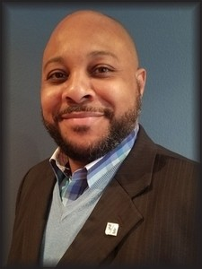


QUESTIONS?
Contact Nigel Hopson
office: 313-736-4513, cell: 313-205-6537
1 Woodward Ave, Detroit, MI 48226 nigel.hopson@53.com mortgageadvisors.53.com/nigel.hopson NMLS# 26897
Contact Jason Paulateer
office: 313-230-9774, cell: 616-366-1557
1 Woodward Ave, Detroit, MI 48226 jason.paulateer@53.com
www.53.com
Loans subject to credit review and approval. Fifth Third Bank, National Association, 38 Fountain Square Plaza, Cincinnati, OH 45263, NMLS# 403245, Third and Fifth Third Bank are registered service marks of Fifth Third Bancorp. CS4534
Equal Housing Lender. Fifth

Slide 28
Journey to Wealth Webinar Series
Wednesday, August 16th – Using Credit in Your Wealth Building Strategy – Constance Stewart of Prudential
Wednesday, August 23rd – Building the Foundation for Financial Freedom – Curtis Baylor of the OPPFFCU
www.oppffcu.com

Slide 29




Contact Us
Info@oppffcu.com
800-42-OMEGA
www.oppffcu.com

