Slide 1
Credit
as Part of Your Wealth Building Strategy
www.oppffcu.com
Presented By : Constance Stewart

Slide 2
About OPPFFCU
Began in 1986
All members of the fraternity are eligible to apply for membership as well as their family members, and members of any of the Divine Nine organizations
Provides life membership loans
The Omega Psi Phi Fraternity was the first of the Divine Nine organizations to start a credit union.
www.oppffcu.com

Slide 3
Products and Services
Accounts
Checking
Savings
Money Market
Loans
Auto
Debt Consolidation
Life Membership
Financial Support (in partnership with Balance Pro)
Coaching for debt, budgeting, home buying, and student loans
Toolkits and Calculators
www.oppffcu.com

Slide 4
About Your Speaker
Has been a financial advisor with Prudential since 2013
She's most proud of hearing from clients about how her team helped improve their life
Member of Delta Sigma Theta Sorority, Inc. Glen Ellyn Area Alumni Chapter
www.oppffcu.com

Slide 5
Agenda
Today we will discuss
What to do when you're overwhelmed in bills
Understanding Your FICO Score and it's affect on your loan approval
The Process for Getting Control of Your Debt
www.oppffcu.com

Slide 6
Buried in Bills!
Are You There?
Are You Headed There?
What Can You Do?
www.oppffcu.com

Slide 7
Digging the Hole
The first steps in being buried:
Obtaining too much credit too fast
Purchasing something with credit that you WANT but don’t necessarily NEED. You know…that 120” television that was originally $2,000 but today and ONLY today, you can get it for $1,750. You didn’t save $250…you spent $1,750.
IMPULSE BUYS!!!
Maxing out your credit cards; again, back to want vs need
New car vs used car
Status vs reality
Small amounts add up quickly
Deferred credit will eventually have to be paid
Bombarded from all directions (Direct mail, TV, Department Stores, etc.)
www.oppffcu.com

Slide 8
Slowly Filling the Hole
While you are standing in the hole:
Your monthly payments on credit slowly start to increase
Your ability to “save for a rainy day” becomes less and less
Your emergency fund dwindles away
You begin to justify purchases (But it will only be $20/mo. if we use this card)
You start using your credit card for things like groceries, gas, and dinner and don’t pay it off each month
You take a cash advance on your credit card and use the money to pay another bill
You find that you don’t have enough money for essential things in between paychecks (You may even use a payday lender to get your through until the next payday)
www.oppffcu.com

Slide 9
Completely Buried
When you can’t see out of the hole (and maybe not be able to breathe):
You get behind on your payments
You have collectors calling/mailing you
Your card is declined at the store
Your car needs repairs and you don’t have the money to fix it
Your furnace goes out and you have no way to pay for the repair
•You get a letter from your credit card company that states they have closed your credit limit
You wonder where you are going to get money for groceries, toiletries, gas, and vehicle/home insurance
You try to consolidate your debt into one payment and are declined OR are approved and paying 10,000% interest
www.oppffcu.com

Slide 10
Case Study: Background
New Teacher
Makes $35,000/yr.
Limited Credit
One small individual credit card-$750 limit-$20/mo. payment
Authorized user on parents' credit card-$9,000 limit-Parents pay
$70,000 in student loan debt in deferment
Rent is $650/mo. and lives by alone
Purchases a new vehicle-$28,000 at 7.50% for 78 months for a monthly payment of $455/mo.
Let’s look at the scenario:
www.oppffcu.com

Slide 11
Case Study: Scenario
Debt to Income Ratio:
$2,917 per month in GROSS income (before taxes)
Rent-$650, credit card-$20, car loan-$455: $1,125 per month
$1,125/$2,917=39% gross debt to income ratio
$2,917 Gross equates to approximately $2,100 Net (take home)
$1,125/$2,100=54% net debt to income
In other words, after paying bills, they has $975 for the rest of the month for other regular monthly bills (Utilities, cell, cable, groceries, gas, insurance, etc.)
How can they save ANYTHING?
What happens when their student loans come out of deferment???
www.oppffcu.com

Slide 12
Case Study: Scenario
Recommendations
Maybe get Vehicle financed elsewhere- Traded down-New payment $312/mo.
Credit card was 24.99%-Switched her card to a 10.99%-She is paying an extra $50/mo. over the minimum required and not charging new credit.
Discussed cell phone plan. Paying for high data usage plan and only used half of the data each month. Lowered their plan and saved her $40/mo.
Discussed cable plan. Rarely home and only watches a few select channels. Found that Comcast offered a basic plan with all of her favorite channels. Saved $60/mo.
When the smoke cleared, they had an additional $296/mo. for the essentials and began a transfer to savings for $75/mo. out of that.
www.oppffcu.com

Slide 13
Shoveling Out
Debt Consolidation?
Pros
All non-secured payments are rolled into one payment
Can lower the rate on many high-rate credit cards
Set term to pay it back-not revolving
Can pay off most of your unsecured debt within 60 months
Cons
Putting a band-aid on a knife wound
Temptation of running the credit cards back up to their limit after you just paid them off
Are you just prolonging the inevitable?
Bankruptcy (pros and cons)
www.oppffcu.com

Slide 14
Shoveling Out
Review Monthly Expenses in Relation to Income:
This is Budgeting 2.0
Write down EVERYTHING you spend money on including a pack of gum or a cup of coffee
Better yet, track it in a program such as Quicken or Mint
You will soon see that you spend WAY too much money on pizza!
Create a budget and stick to it. I have heard people refer to it as being as hard as quitting smoking or losing weight
Track your Credit Report
www.annualcreditreport.com
You may be surprised to see an unpaid medical collection or two!
Learn how to read your credit report. It is NOT just about a score.
www.oppffcu.com

Slide 15
Shoveling Out
Other Considerations:
Know your debt-to-income ratio:
Monthly payments/gross monthly income=debt to income ratio
Monthly payments/net monthly income is a better indicator
A 40% net debt to income ratio means different things to different people
If you make $25,000/yr (net income) with a debt to income of 40%, you have approximately $1,250/net income per month for essential expenses
If you make $50,000/yr (net) with a debt ratio of 40%, you have approximately $2,500/net per month for essential expenses
Watch your unsecured amount outstanding:
You do not want your monthly unsecured debt to be any greater than 10% of your income annualized.
Example-$1,000 total outstanding unsecured balances/$36,000 annual income=3% unsecured ratio.
Unsecured debt is the #1 indicator of bankruptcy. It is important that you address your unsecured debt first!
www.oppffcu.com

Slide 16
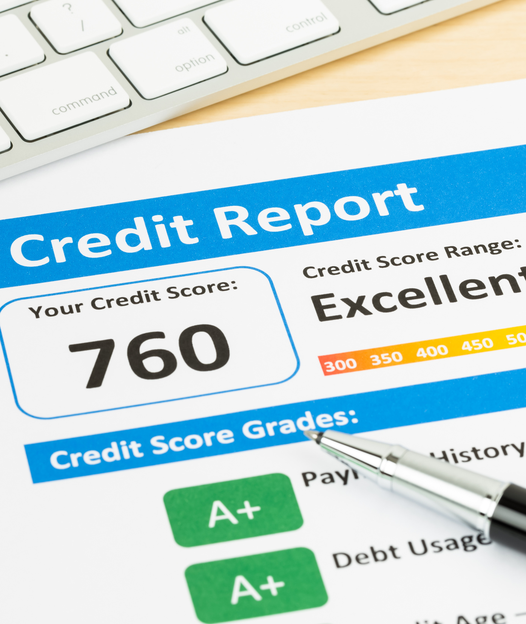
What Makes a Credit Score?
Important Positives
Mortgage loans
Installment loans
Balanced revolving (Credit cards, line of credit, etc.) debt
Minimal inquiries
Important negatives
Late payments
Limited credit
Unpaid collections/judgments/tax liens
Open bankruptcies
Maxed out credit cards
Large amounts of inquiries
www.oppffcu.com

Slide 17
Scores and Affect on Loan Approval and Interest Rates
Credit Scores are used in two manners:
Loan Approval (Risk-Based Underwriting)
Interest rates paid on loans (Risk-Based Pricing)
Risk-Based Underwriting
Instant approval based solely on your credit score
Risk-Based Pricing
IF your loan is approved, your interest rate is based on your credit score
Other factors such as time on the job, time of residence, debt-to-income ratio, etc. still come into play.
www.oppffcu.com

Slide 18
www.oppffcu.com

Slide 19
Benefits of Good Credit
Lower interest rates on credit cards and loans.
Better chance for credit card and loan approval.
More negotiating power.
Better chance of approval for higher borrowing limits.
Easier approval by landlords.
Better car insurance rates.
Cellphone contracts without a security deposit
www.oppffcu.com

Slide 20
The DFree Challenge
The Challenge is to take control of your finances by creating debt reduction goals, forming online support groups, and most importantly - paying off your debt.
1: List debts in order from smallest to largest balance.
2: Attack debt by paying as much as you can on your smallest balance.
3: Once you’ve paid the first debt off, move the entire payment to the next item on your list.
When you pay off your debt, you improve your creditworthiness, reduce stress and create additional income for savings and investments.
www.oppffcu.com

Slide 21
BE WISE
Know your credit; including your credit score!
Understand your debt-to-income ratio and how that affects your ability to secure credit in the future.
Determine wants over needs. Avoid impulse buys!
Know the warning signs that you may be getting in too deep.
If you feel you are getting too deep, track all of your expenses including that coffee that you get from Starbucks each day.☺
Make a plan to live within your means and stick with it before you consider a potentially negative situation with consolidations.
W...…...WISDOM
I……....INVESTING
S……...SAVINGS
E….…..ECONOMICAL FREEDOM
www.oppffcu.com

Slide 22
Building Wealth
Your credit score is one of the most important numbers in your life. This three-digit number indicates your creditworthiness or the likelihood that you'll repay the money you borrow. Credit scores generally range from 300 to 850. The higher your credit score, the more likely it is you'll be approved for new and better credit.
8 Steps to Help You Build Wealth
Start by making a plan
Make a budget and stick to it
Build your emergency fund
Automate your financial life
Manage your debt
Max out your retirement savings
Stay diversified
Up your earnings
www.oppffcu.com

Slide 23
Contact Us
Learn more about our services
Info@oppffcu.com
800-42-OMEGA
www.oppffcu.com

Slide 24
QUESTIONS?

